Slide 1

Chapter 4
Sharing Files

Slide 2
Chapter 4 Overview
Tailored File Sharing
User Groups
File Permission Flags
Access Control Lists
Apple OS X Access Control Lists
Windows Access Control Lists
Monitoring System Security

Slide 3
Tailored File Sharing
Example
  Bob and Tina shall be able to read and modify the survey data
  No one except Bob and Tina have access to the survey data
When tailoring, we answer 4 questions
  Which resources are we managing?
  Which users have access?
  Deny by Default or modify the existing rights?
  What access rights do non-owners have?

Slide 4
Tailored Policies
Privacy
  Overrides a global file sharing policy
  Protects a set of files from access by others
Shared Reading
  Overrides a global isolation policy
  Grants read access to a set of files
Shared Updating
  Overrides either global policy
  Grants read and write access to a set of files

Slide 5
How do we tailor the access rights?
Can’t do it with simple permission flags or with compact access rules
  We need more than just Owner, System, or World
Simple File Sharing on Windows
  Keeps a list of users granted access to a particular directory tree
  Access Options:
    Read-only access, Contributor access
    Co-owner access, Owner access

Slide 6
User Groups
Each file has a set of group access rights, and the ID of an established group of users
  “World” is a group that contains all users
  Other groups must have a file that lists the users in each group
The OS applies group rights, as well as other rights, when deciding whether a process is allowed access to a resource.
We create a group by creating a list of users in that group, and then giving the group a name.

Slide 7
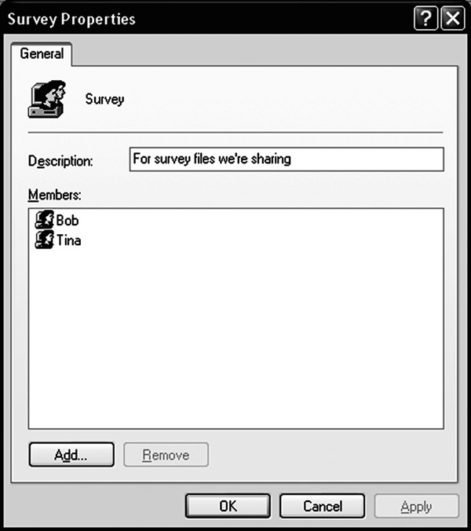
Creating a Group in Windows
Used with permission from Microsoft.

Slide 8
Solving Bob’s Problem
We create a folder for the project files
  The folder must be visible to Bob and Tina
  The folder “belongs” to the “Survey” group
    Actually, one user owns each file
    The file’s group is a separate setting
Access Rights for the folder and its files
  Owner: RW-
  Group: RW-
  World: ---

Slide 9
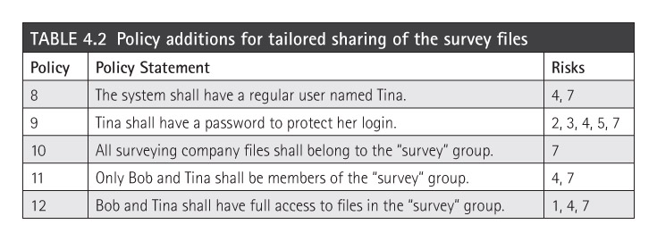
File Sharing Policy
Bob and Tina’s project yields another risk:
  7. Disclosure of the survey files to people outside the project
Policy added to Tables 3.3 and 3.4

Slide 10
Administrative Groups
Many systems have a separate “Admin” group
  User IDs who are part of the group may perform administrative tasks
  Restrict access to administrative functions by blocking the right to execute the programs
  Windows also associates other privileges with user groups, including administrative rights
If a user is in the “Admin” group, they automatically have access to administrative functions

Slide 11
Privileged User IDs
Classic Unix had a “root” user ID
Admins logged in as “root” to perform administrative tasks
  Problem: the system couldn’t tell which admin performed a particular task. Accountability
Modern Unix has “SUDO” and “SetUID”
  User with administrative role uses one of these commands to execute a privileged operation as “root”
  Similar to OS-X “unlock” and Windows UAC

Slide 12
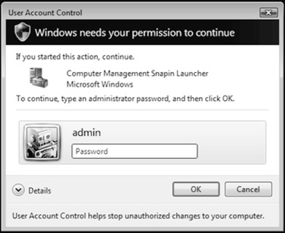
Windows User Account Control
Used with permission from Microsoft.

Slide 13
Administration and Least Privilege
Administrative roles pose a danger
  If an admin user executes a Trojan horse program or a virus, the malware can use the administrative rights to modify the OS itself
  This risk applies to “root” users and to members of “admin” user groups
Safe alternative: temporary rights (UAC)
Safe alternative: Have two User IDs
  Regular user ID has no special privileges
  Special user ID has administrative privileges

Slide 14
File Permission Flags
Traditional Unix uses file permission flags to indicate access rights
  Modern Unix systems may also use access control lists (ACLs) – will discuss later
Three sets of RWX flags
  Owner Rights (called “user rights” or “u”)
  Group Rights (called “group rights” or “g”)
  World Rights (called “other rights” or “o”)
Specified in that order: owner-group-world
  “rwxrwxrwx” gives everyone full access rights

Slide 15
Unix Permission Flags
Unix keyboard commands use these codes to specify and report on file access rights
Example: “ls” the list directory command:
$ ls -l
total 56
-rw-r--r--@ 1 rick ops 4321 Nov 23 08:58 data1.txt
-rwxr-xr-x 1 rick ops 12588 Nov 23 10:19 hello
-rw-r--r--@ 1 rick rick 59 Nov 23 10:18 hello.c
data1.txt and hello.c are text files
hello is an executable file, owned by “rick”
Everyone can read them, owner can write them

Slide 16
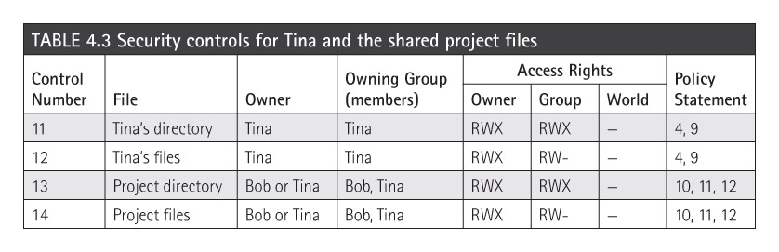
Controls for the Survey Group
We add these to the security controls listed in Table 3.7.
We also need implementation steps that add Tina’s user ID and password to the system

Slide 17
Permissions and Ambiguity
Can Tina read a file with these permissions:
  Owner: Bob – RWX
  Group: Survey (Bob and Tina) – no access
  World: R—
Answer: depends on the operating system
  On OpenVMS: YES
    Permissions are combined, then checked
  On Unix: NO
    Applies the list that applies closest to Tina: the group permissions

Slide 18
Access Control Lists (ACLs)
The general-purpose technique cluster access rights by row (by resource, by file)
  Simple permission flags require a small, fixed amount of storage for each file
  ACLs may be arbitrarily long
    Poses a challenge for the OS
An alternative to User Groups
  We simply keep a list of individuals with the right to access a particular file or folder
  Efficient if each file needs its own tailored list

Slide 19
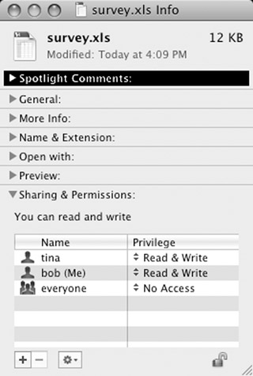
OS-X ACLs
Based on Unix permission flags
  Provides owner/group/ world rights by default
GUI only provides RW access controls
Keyboard commands provide more sophisticated controls
Screenshot reprinted with permission from Apple, Inc.

Slide 20
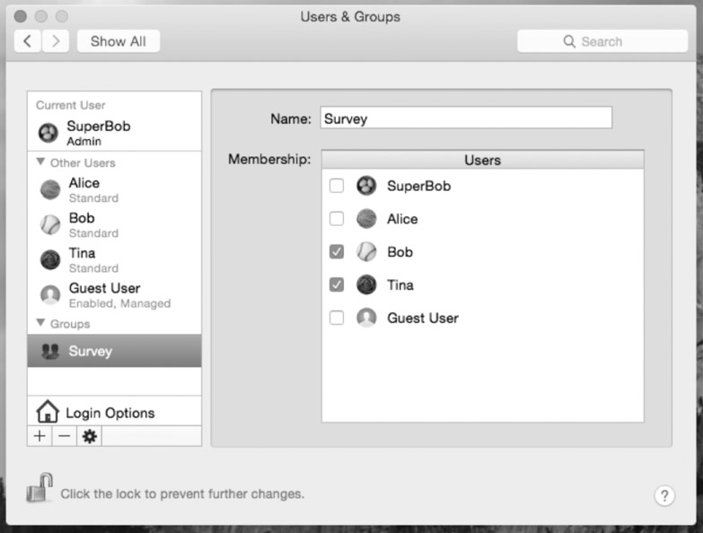
OS-X Groups
Screenshot reprinted with permission from Apple, Inc.

Slide 21
Microsoft Windows ACLs
Present in “Professional,” “Business,” and other sophisticated versions of Windows
  “Home” and “Basic” versions use the simple access lists described earlier
Each ACL entry gives permission for a specific user or group
  Users and groups are defined on the computer or by a network-wide “Domain”
  Each entry specifies a list of permissions
  Each permission may be “Permit” or “Deny”

Slide 22
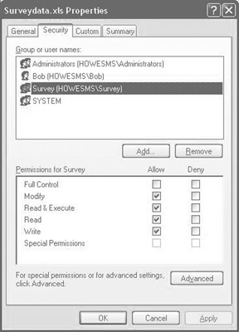
Windows ACL Example
Used with permission from Microsoft.

Slide 23
Applying a Windows ACL
Permissions are applied in a specific order:
  Permissions specifically assigned to that file or directory are applied first
  Next, apply those inherited from the enclosing directory
  If more permissions inherited, apply them in inheritance order: most recent to least recent
For each set, we apply Deny rules first
As soon as we find a permission that matches this user or process, we stop and apply it

Slide 24
Building Effective ACLs
Deny by Default is the best general approach
  Start with no rights, or a small set of defaults
    Permissions to owner and administrators
  Add “Allow” rights as needed
Keep the rules as simple as possible
Example that needs a “Deny” right
  A group of all students called “Students”
  Need a group “Students Minus Freshmen”
  Easiest approach: Deny “Freshmen” group

Slide 25
Default File Protection
Windows uses device, directory, and folder rights to establish default protections
  The rights are inherited from enclosing folders
  Inheritance is dynamic
    If we change rights on an outer folder, it may change rights on an inner folder
    Most other ACL implementations are static
      Changes do not affect existing rights
We can enable and disable inheritance
  Often disabled to apply special rights

Slide 26
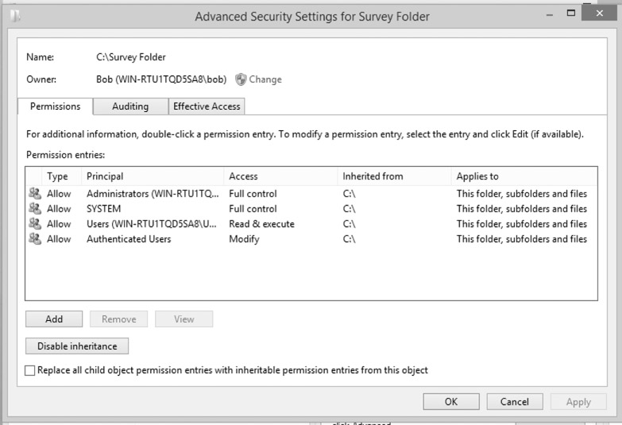
Example of Inherited Rights
Used with permission from Microsoft.

Slide 27
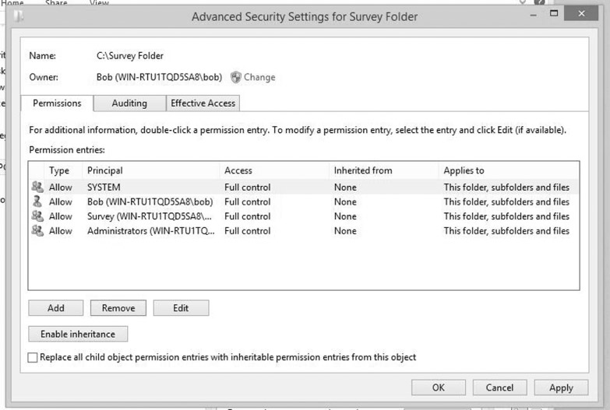
Overriding Inherited Rights
Used with permission from Microsoft.

Slide 28
A Trojan Horse
Tina plays a video game that Eve has installed on Bob’s shared computer.
Bob then discovers that someone has copied his protected files into the game’s folder.
  How did this happen?
The game was a Trojan horse program
  In addition to implementing the game, the program also copied files that Bob owned
  It used Bob’s access rights to copy his files

Slide 29
How the attack worked
Transitive Trust – a basic principle
  If we trust Program 1, and it trusts Program 2, then we are also trusting Program 2
  If we run a program, then we trust its author
Bob trusted the game program: the program copied Bob’s files to Suitemates’ folder
Resources | World access rights | Effective Access By Bob | Effective Access By Suitemates
Bob’s secret files | --- | RW- | ---
Suitemates’ game file | R-X | R-X | RWX
Suitemates’ copy of Bob’s secret files | RW- | RW- | RW-

Slide 30
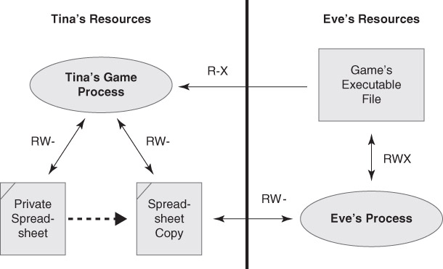
The Trojan in Operation

Slide 31
Monitoring System Security
Effective security requires monitoring
  Defenses may only detect and delay
  Alarms are useless if no one listens
Access controls are preventative – they try to block an attack from succeeding
Monitoring is detective – it detects the attack without necessarily blocking it
  Often provided through logs:
    Event logs and audit logs

Slide 32
The “Wily Hacker”
Found by astronomy grad student Clifford Stoll
  Pursued 75 cent shortage in accounting
  Found a spy in Germany who penetrated many US universities and defense sites
Shortage was a mismatch between system event logs and the accounting logs
  The attacker used processor resources
  The attacker’s work didn’t yield a charge in the accounting logs
Story became a bestselling book

Slide 33
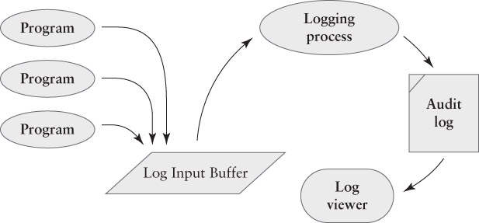
The event logging process

Slide 34
The Logging Mechanisms
A process shared by all system components
  A program detects a significant event, and emits a log entry to describe it
  The logging process retrieves the event, and discards less-significant events
  The logging process saves the event in a log file.
  Administrators monitor the logs for significant events that demand action
Avoid collecting too few – or too many – events

Slide 35
External Security Requirements
Logging does not directly improve system performance or security – it may help detect and resolve problems, or it might not
  Appears more “efficient” to disable logging
  Benefits are indirect
Most systems keep logs to comply with External Security Requirements
  Based on laws, government regulations, industry standards, or a combination of them

Slide 36
Industry Security Standards
ANSI X-standards
  Used by the banking industry to protect electronic funds transfers
PCI-DSS
  Used by “Payment Card Industry” to protect credit card transactions
ISO 27000
  Family of international standards for security system quality improvement

Slide 37
US Government Standards
FIPS – Federal Information Processing Standards
SOX – Sarbaines-Oxley – financial and accounting standards for public companies
HIPAA – Health Information – security standards for certain types of personal health data
GLBA – Gramm-Leach-Bliley – standards for protecting personal financial information
FISMA – Federal information management – security standards for federal computer systems

